Slide 1
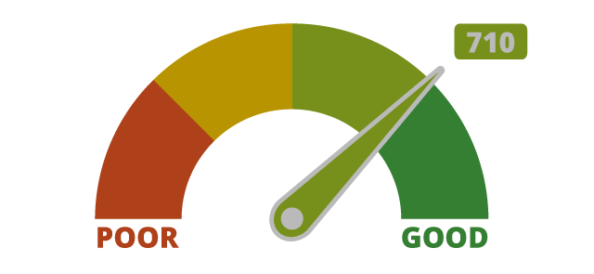
Credit Score Classification Using Machine Learning
By Faiza Ayoun | Sanjana Balagar | Ha Phan | Aswini Pusuluri | Sowmya Ravichandran

Slide 2
Motivation
Credit score is
Very Important for Financial institutions (Banks)
Used for risk assessment for loaners
Determines the amount of loans
Helps for credit approvals or denials

Slide 3
Dataset used
Dataset from Kaggle Link https://www.kaggle.com/datasets/parisrohan/credit-score-classification
Contains basic bank details and some credit-related information.
Size is about 31.14 MB , 28 columns and 100000 rows.
The target feature is “Credit Score” with three classes:
Good, Standard, and Poor.

Slide 4
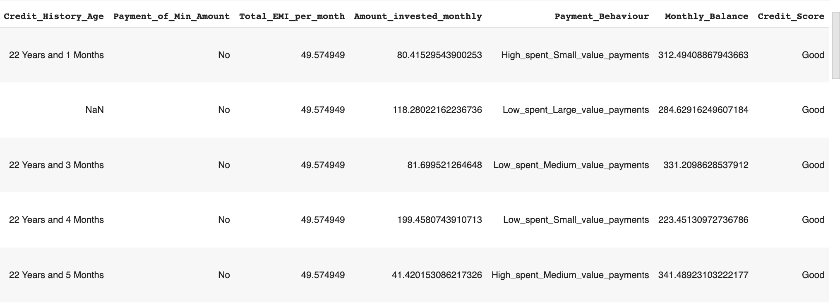
Data Sample

Slide 5
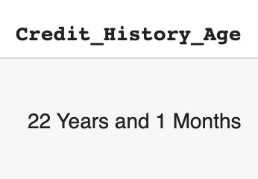
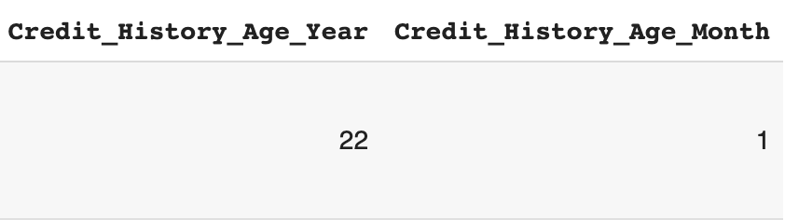
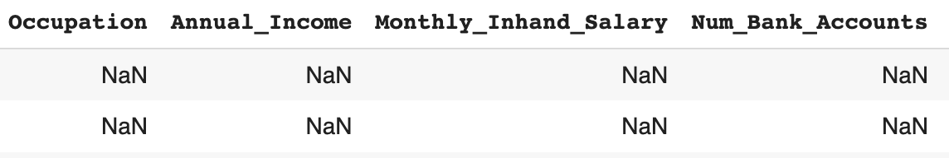
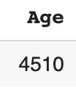
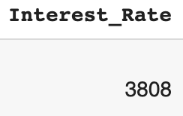
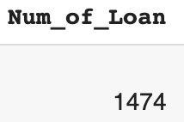
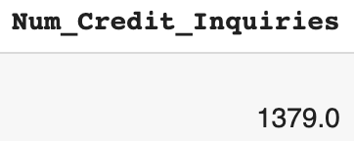
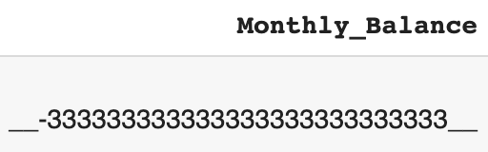
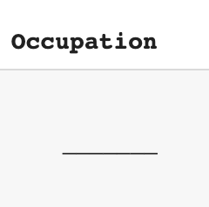
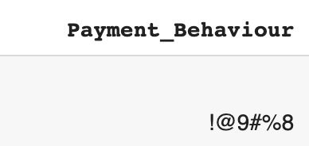
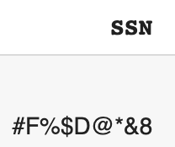
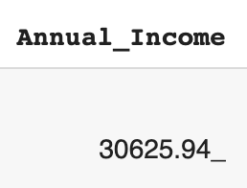
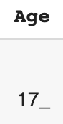
Data Cleaning
Convert Credit History Age to 2 columns
Fill up Null Values with appropriate values
Change Data Types
Fix or Remove outliers
Remove or Replace spacial characters

Slide 6
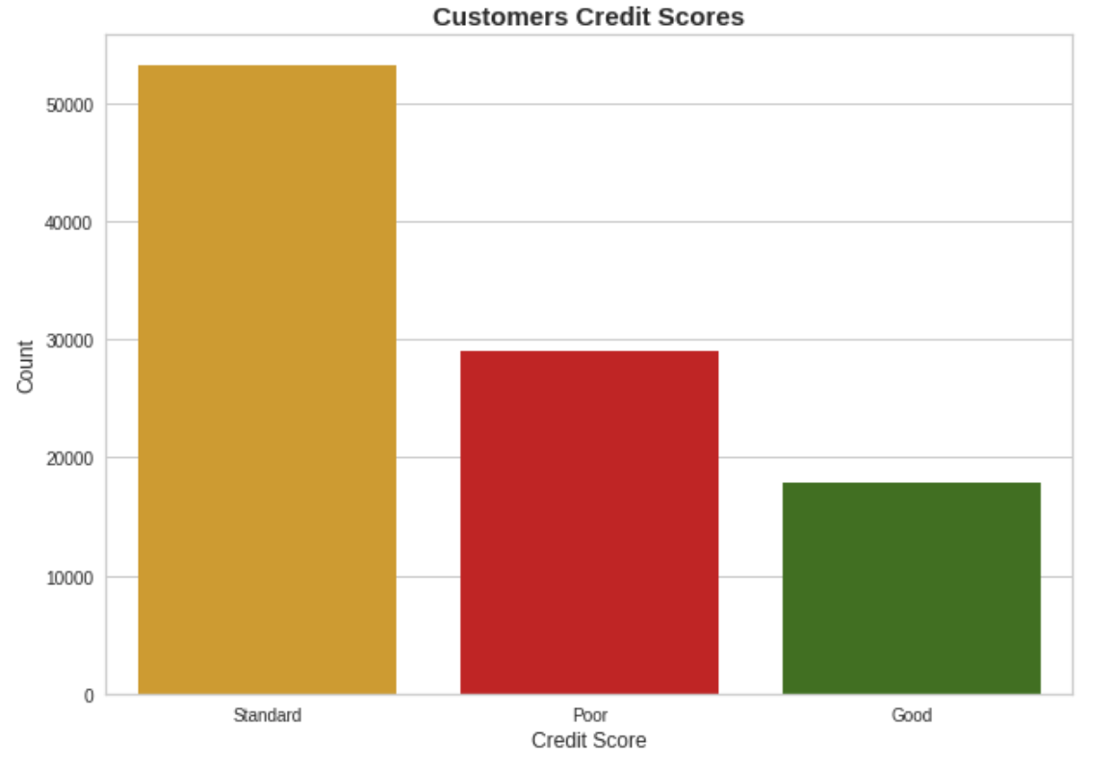
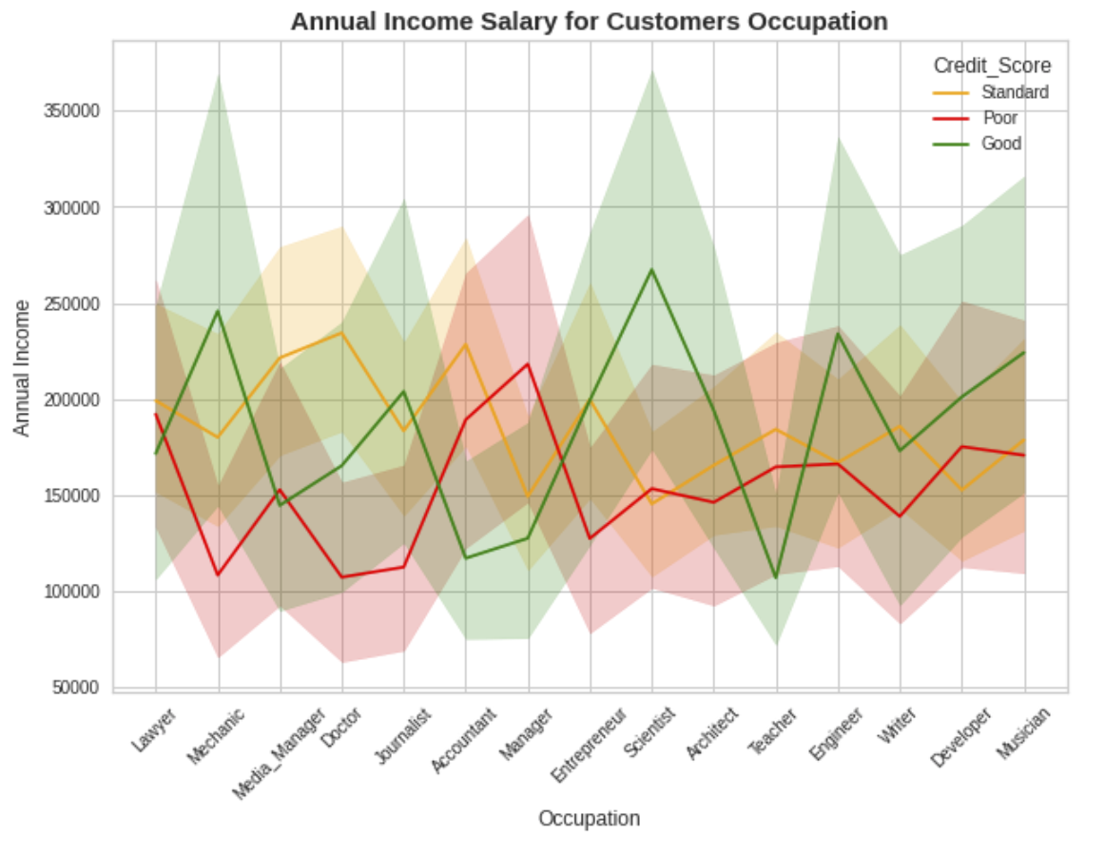
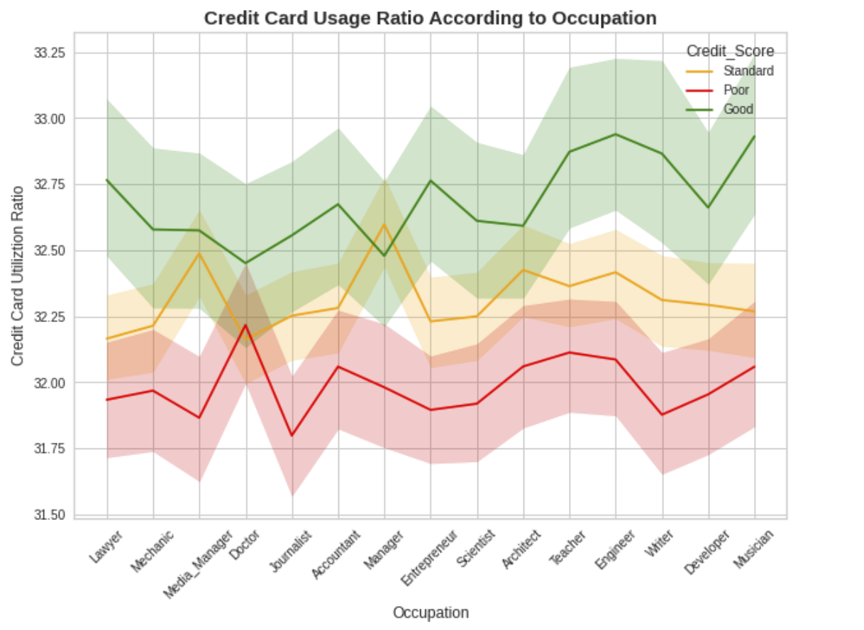
EDA
Our dataset is Imbalanced
Annual income does not affect credit score

Slide 7
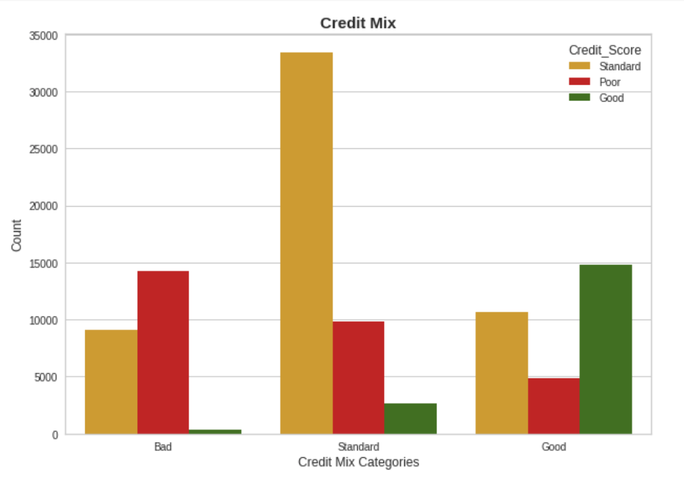
EDA Cont..
Bad credit mix -bad credit score
Standard credit mix - standard credit score
good credit mix - good credit score
Usage of the credit card is more, than the credit score will be good

Slide 8
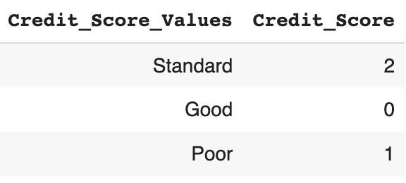
Data Preparation
Data Normalization
Label Encoding
Splitting Data into Train and Test datasets

Slide 9
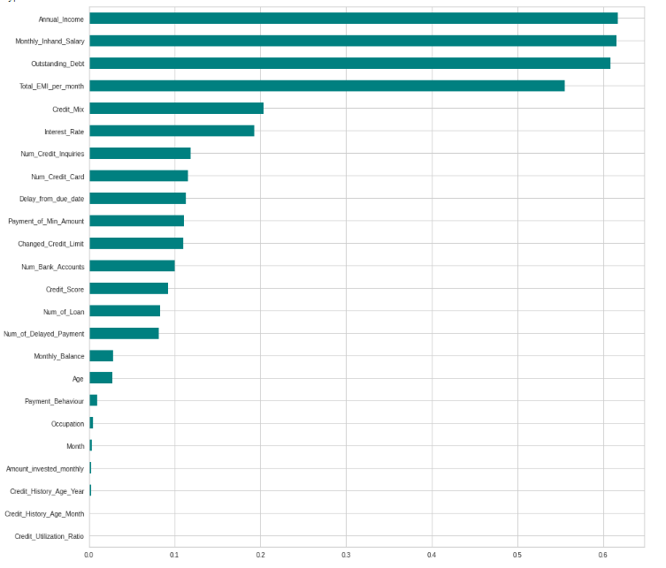
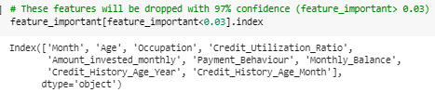
Feature selection Using Information Gain

Slide 10
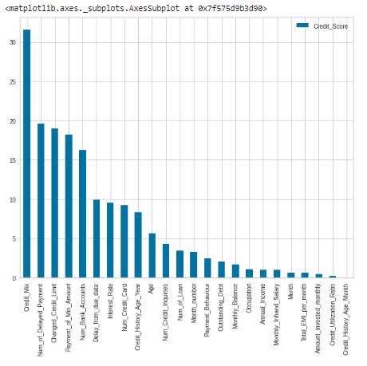
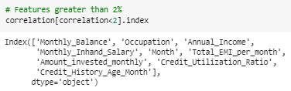
Feature selection Using Correlation Coefficient

Slide 11
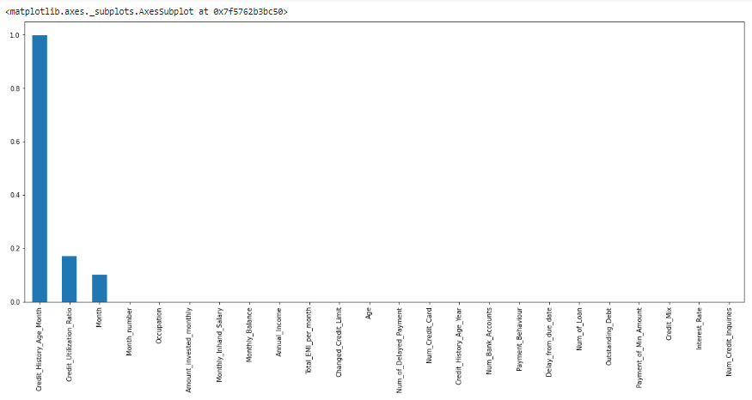
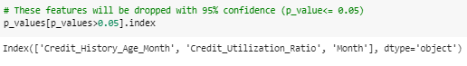
Feature selection Using Chi-Square

Slide 12
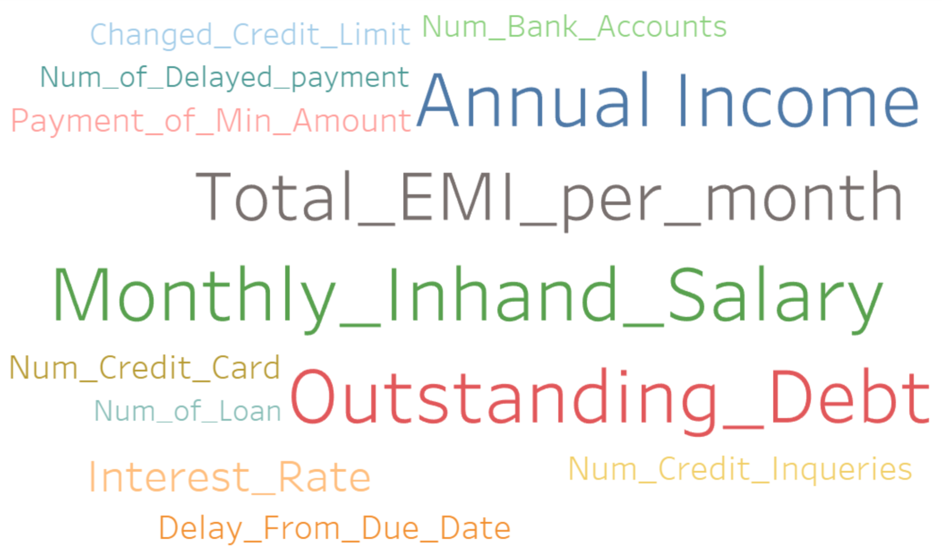
Most important features
Annual_Income, Monthly_Inhand_Salary : Capability to pay the credit
Delay_from_due_date, Outstanding_Debt, Num_of_Delayed_Payment : Consistency to pay credit

Slide 13
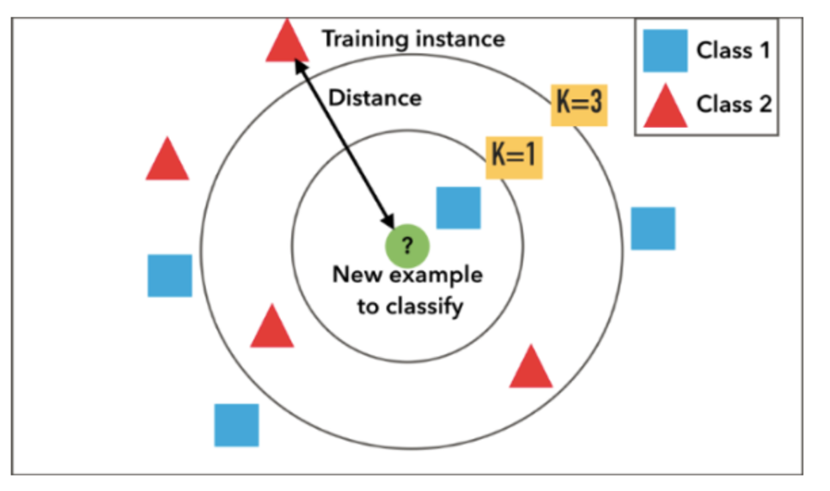
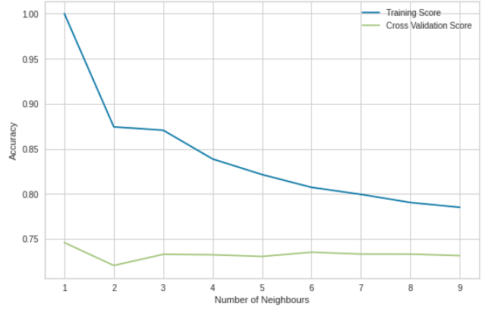
K-Nearest Neighbor

Slide 14
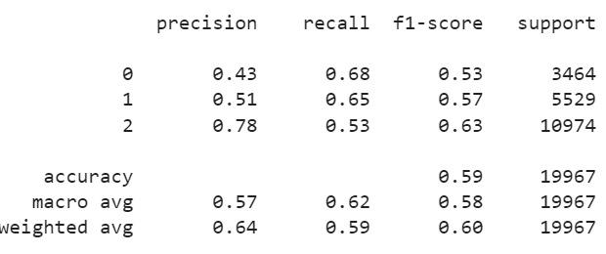
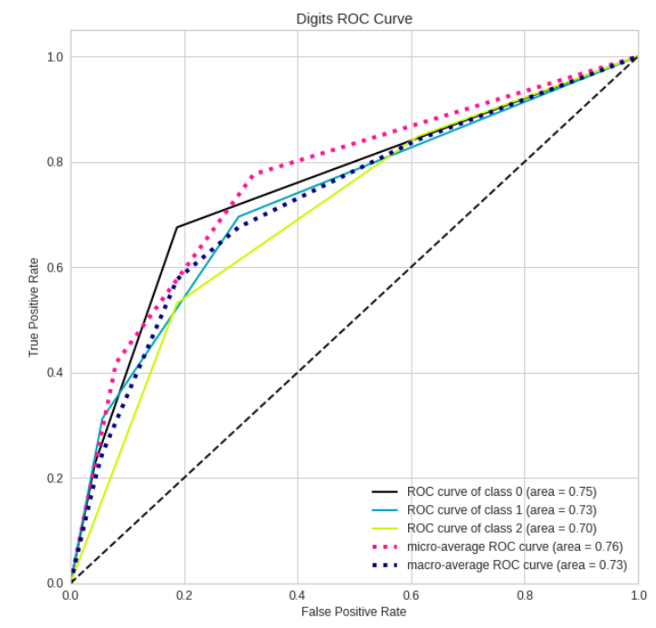
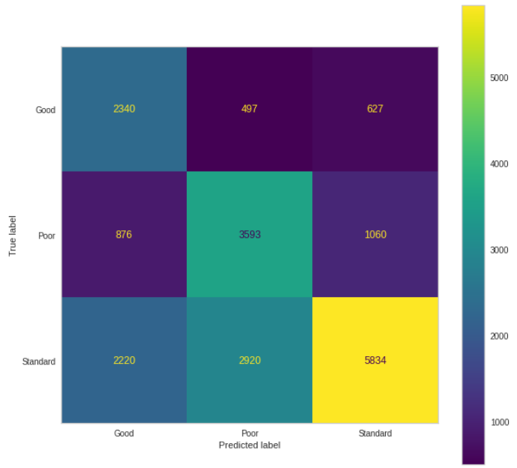
Modeling With KNN- All Features

Slide 15
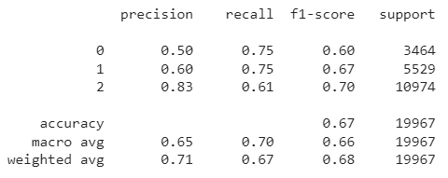
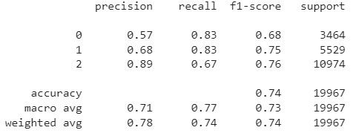
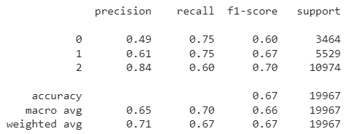
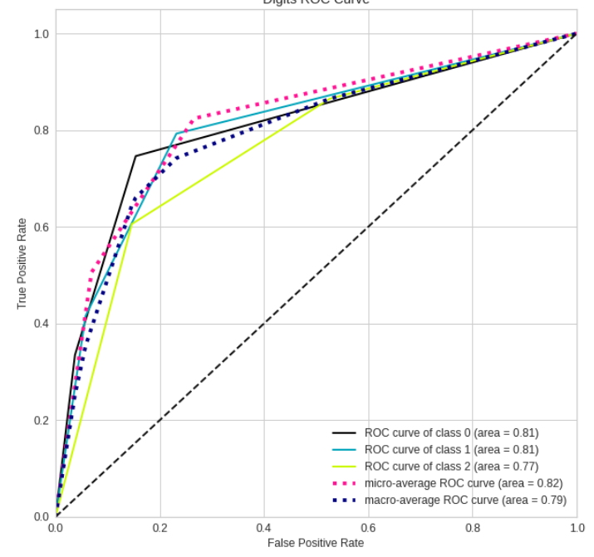
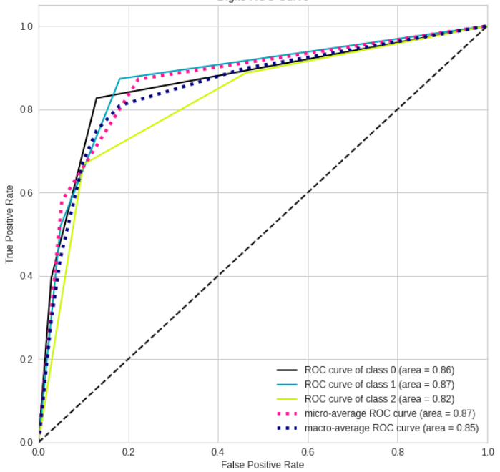
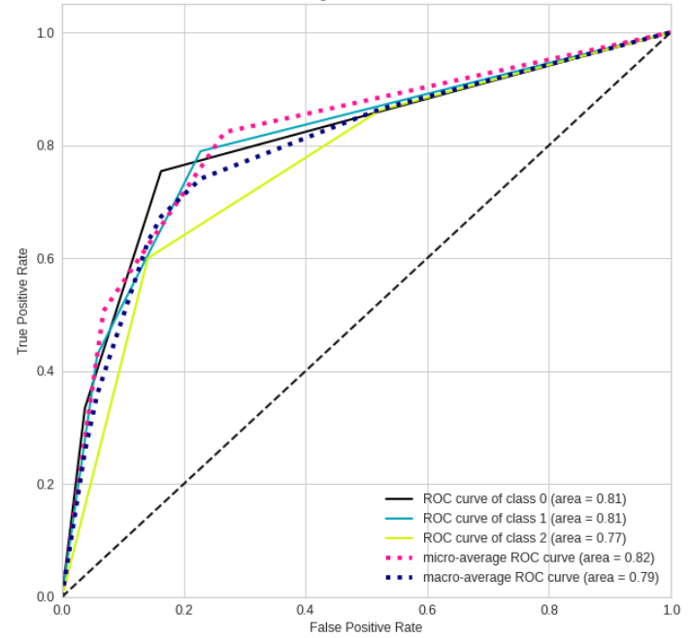
KNN with Feature Selection
Chi-Square
Information gain
Correlation Coefficient

Slide 16
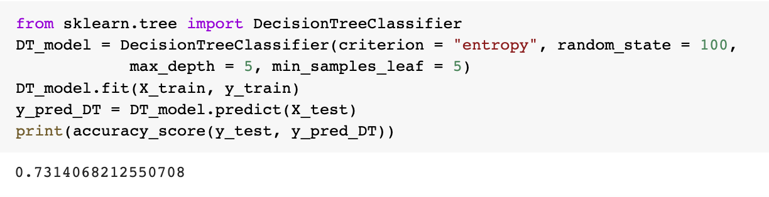
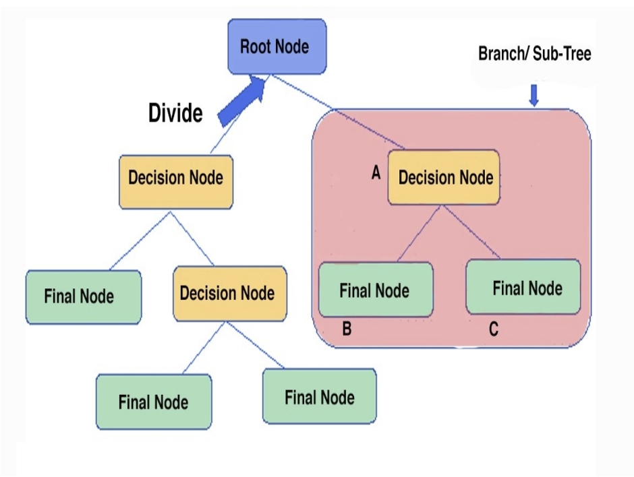
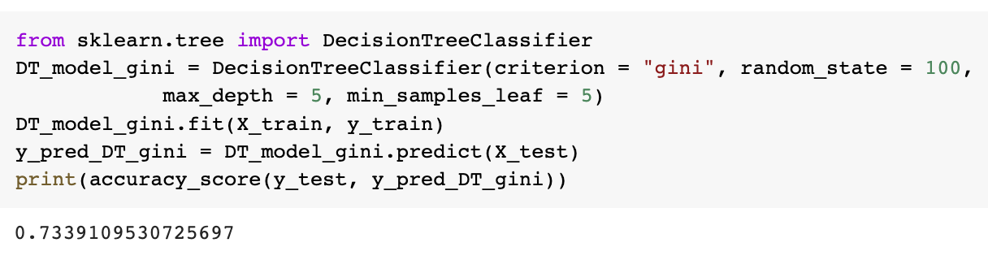
Decision Tree

Slide 17
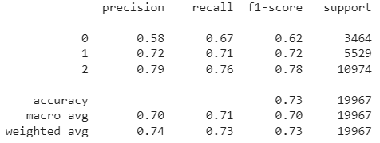
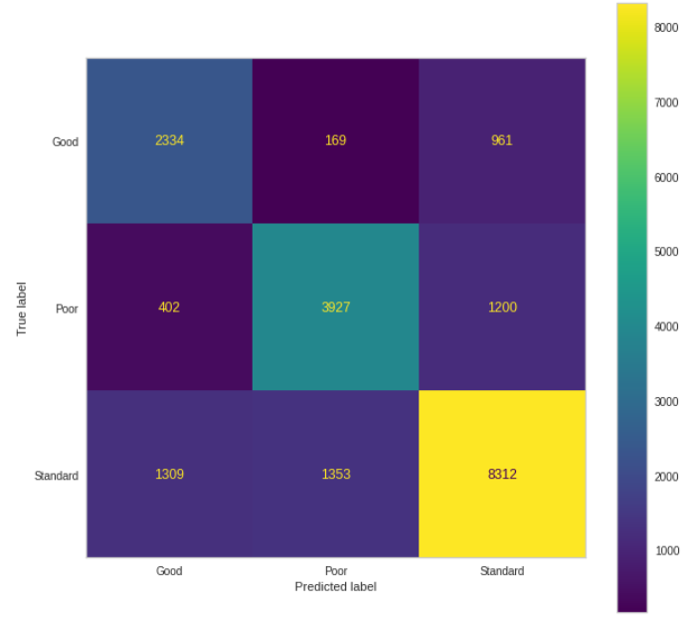
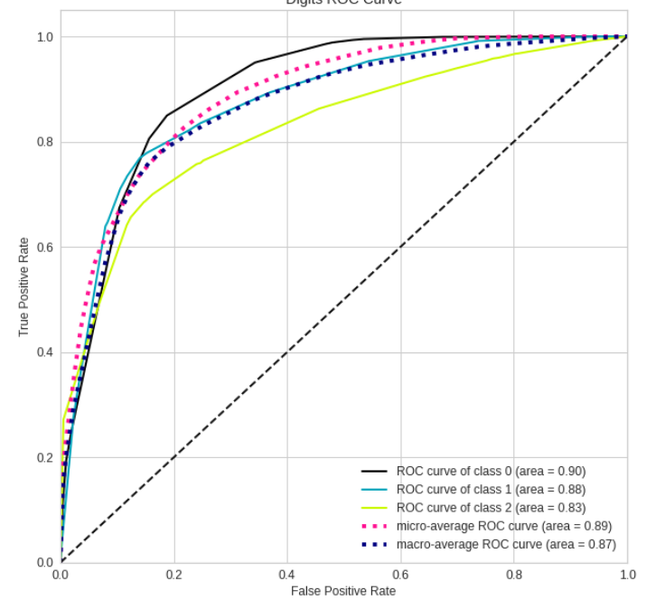
Modeling With Decision Tree- All Features

Slide 18
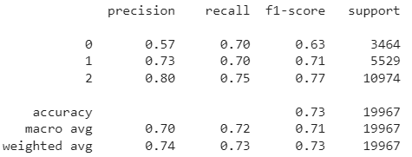
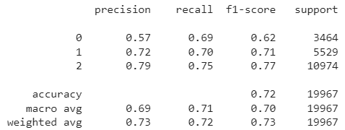
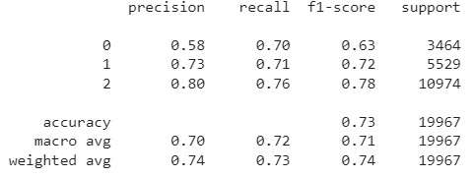
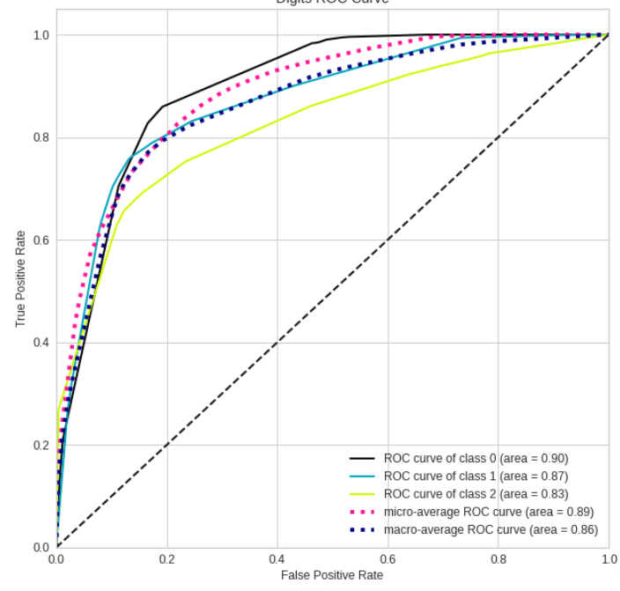
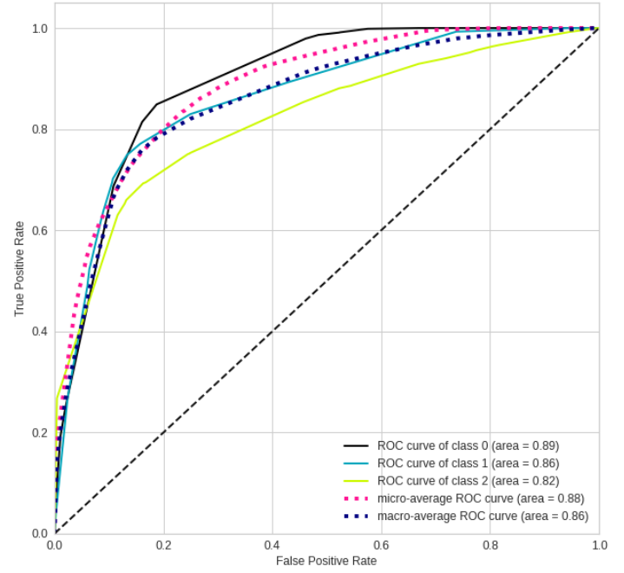
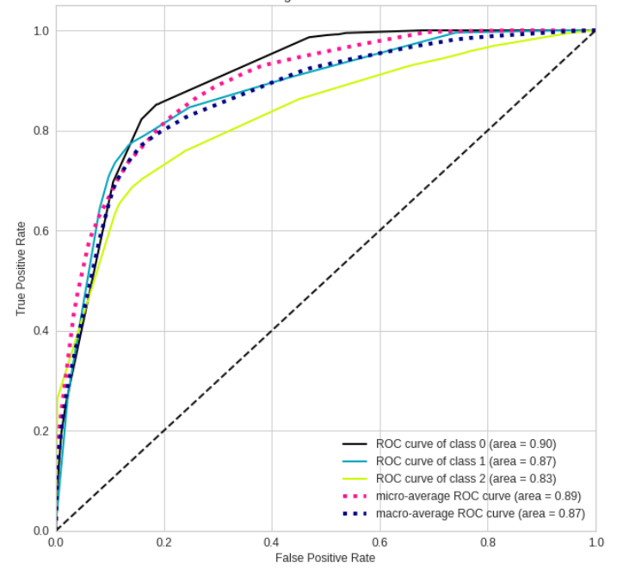
Decision Tree with Feature Selection
Chi-Square
Information gain
Correlation Coefficient

Slide 19

RandomForest

Slide 20



Modeling With Random Forest

Slide 21






Random Forest with Feature Selection
Chi-Square
Information gain
Correlation Coefficient

Slide 22


Gaussian Naive Bayes

Slide 23



Modeling With Gaussian Naive Bayes

Slide 24






Gaussian Naive Bayes with Feature Selection
Chi-Square
Information gain
Correlation Coefficient

Slide 25

XGBoost

Slide 26



Modelling with XGBoost

Slide 27






XGBoost
Chi-Square
Information gain
Correlation Coefficient

Slide 28
Model Comparison - All Features
 | KNN | Decision Tree | XGBoost | RF | Naive Bayes
Accuracy | 0.58 | 0.73 | 0.74 | 0.82 | 0.69
F1-Score | 0.57 | 0.71 | 0.71 | 0.81 | 0.68
Precision | 0.57 | 0.70 | 0.70 | 0.80 | 0.67
Recall | 0.61 | 0.72 | 0.73 | 0.81 | 0.72

Slide 29
Model Comparison - Selected Features
 | KNN (Information Gain) | Decision Tree (Correlation Coefficient) | XGBoost (Information Gain) | RF (Information Gain) | Naive Bayes (Correlation Coefficient)
Accuracy | 0.74 | 0.73 | 0.74 | 0.839 | 0.70
F1-Score | 0.72 | 0.70 | 0.71 | 0.830 | 0.68
Precision | 0.71 | 0.70 | 0.70 | 0.828 | 0.67
Recall | 0.77 | 0.72 | 0.73 | 0.832 | 0.72

Slide 30
Why certain models not good for our Data
Naive Bayes
Naive bayes assumes that features are independant, but in our dataset many features are related like Monthly in hand salary and annual income
Most features doesn’t follow Gaussian Distribution
Decision Tree
The decision tree model gives high importance to a particular set of features in our dataset.
Faster to train with our data but it fails to generalize over the data in a better.
Random Forest
Ensemble learning method
The results are relatively robust to unbalanced data (Li & Chen, 2020)
XGBoost
Since XGBoost takes into consideration the weight calculations the feature selection is done internally and hence we don't see any difference when we try the three different ways of feature selection
K-Nearest Neighbor
KNN works well with a small number of input variables, but struggles when the number of inputs is very large. In our case, we have considered more than 15 features.

Slide 31
Extracted Knowledge From Data
The age is not an important attribute to grant credit, as long as the individual has good credit history and good income.
Number of bank accounts a individual have does not matter for a bank to grant a loan until unless they have any fraudulent transactions in there accounts.
Monthly in hand salary: people with high in hand salary, above 5000 tend to have good credit score, lesser than 3500: have poor credit, between 4000-4500: tend to have standard credit score
Credit Card Utilization ratio- If the usage of the credit card is more, then the credit score will be good.
People with good credit mix (mortgages, loans, credit cards) will have a good credit score.

Slide 32
Conclusion
In comparison to the other models taken into consideration, the Random Forest Model produced the best results.
All features - RF model gave a accuracy of 82%.
Selected features- accuracy of 84%.
Feature selection improves the process' accuracy and increases prediction power of the algorithms.

Slide 33
References
https://www.kaggle.com/datasets/parisrohan/credit-score-classification
Li, Y., & Chen, W. (2020). A Comparative Performance Assessment of Ensemble Learning for Credit Scoring. Mathematics, 8(10), 1756. https://doi.org/10.3390/math8101756

Slide 34
Thank you

